Slide 1
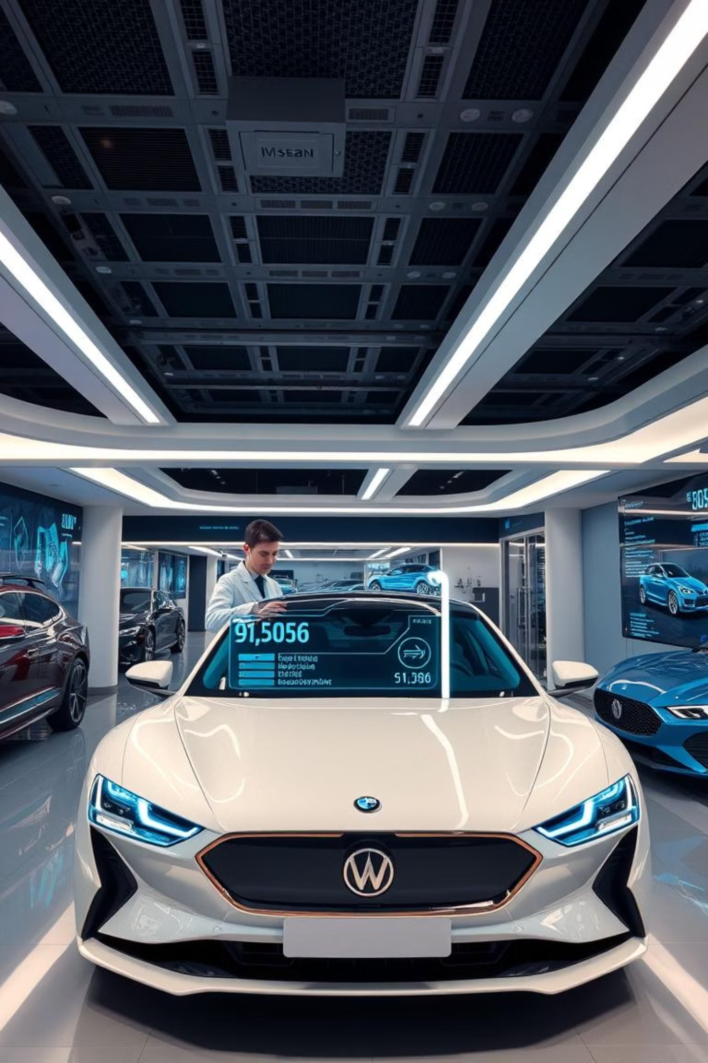

Car Dheko - Used Car Price Prediction
Welcome to a deep dive into our innovative project at Car Dheko, aimed at transforming the used car market through advanced machine learning.

Slide 2
Project Goals and Scope
As data scientists at Car Dheko, our objective is to enhance customer experience and streamline pricing using machine learning. We are developing an accurate, user-friendly Streamlit tool for predicting used car prices.
Problem Statement
Project Scope
Current pricing methods lack real-time adaptability and comprehensive feature integration, leading to inconsistencies and manual effort.
Leveraging historical CarDekho data (make, model, year, fuel, transmission, city), we build an ML model and integrate it into a Streamlit app for instant price estimates.

Slide 3




Key Skills Acquired
Data Processing
Exploratory Data Analysis
Mastering techniques for cleaning, structuring, and preparing raw data for modeling.
Uncovering insights and patterns through statistical summaries and visualizations.
ML Model Development
Streamlit Deployment
Building, training, and optimizing machine learning models for accurate predictions.
Developing interactive web applications for real-time model accessibility.

Slide 4






Data Processing: From Raw to Ready
Our initial phase focused on transforming unstructured city-specific data into a unified, clean dataset suitable for machine learning.
Concatenate Datasets
Import, structure, and merge all city datasets, adding a 'City' column for context.
Handle Missing Values
Impute numerical (mean/median) and categorical (mode/new category) missing data.
Standardize Formats
Convert data types (e.g., "70 kms" to 70), ensuring consistency across all features.
Encode Variables
Transform categorical features to numerical using one-hot or label encoding.
Normalize Features
Scale numerical features (0-1 range) with Min-Max or Standard Scaling.
Remove Outliers
Identify and manage outliers using IQR or Z-score to prevent model skewing.

Slide 5
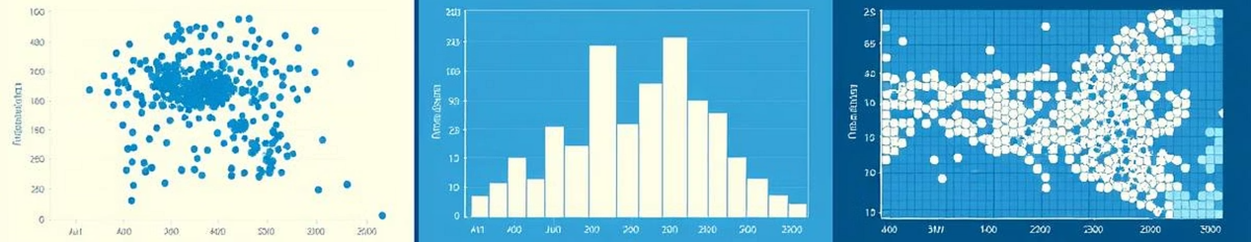
Exploratory Data Analysis (EDA)
EDA helped us understand data distribution, identify patterns, and select the most impactful features for car price prediction.
Descriptive Statistics: Calculate mean, median, mode, and standard deviation to summarize data.
Data Visualization: Utilize scatter plots, histograms, box plots, and heatmaps for insights.
Feature Selection: Employ correlation analysis, model importance, and domain knowledge to identify key features.

Slide 6






Model Development and Evaluation
We meticulously selected, trained, and fine-tuned machine learning models to achieve optimal predictive accuracy for used car prices.
Train-Test Split
Model Selection
Divide data (70-30 or 80-20) for robust model evaluation.
Choose algorithms like Linear Regression, Random Forests, or Gradient Boosting.
Model Training
Hyperparameter Tuning
Train models with cross-validation for reliable performance.
Optimize parameters using Grid Search or Random Search.
Performance Metrics
Model Comparison
Evaluate using MAE, MSE, and R-squared for accuracy.
Select the best model based on comprehensive evaluation metrics.

Slide 7
Optimization and Deployment
Our final steps involved refining the model's performance and deploying it as an accessible, interactive Streamlit application.
Optimization
Deployment
Feature Engineering: Create new features or modify existing ones based on domain knowledge.
Streamlit Application: Deploy the model as an interactive web app for real-time predictions.
Regularization: Apply Lasso (L1) and Ridge (L2) to prevent overfitting.
User Interface Design: Ensure intuitive design with clear instructions and error handling.

Slide 8
Project Outcomes
This project culminates in a robust pricing tool, comprehensive analysis, and a user-friendly application for Car Dheko.
Accurate ML Model
Detailed Insights
A functional and precise model for used car price prediction.
Comprehensive data analysis and visualizations of the dataset.
Interactive Tool
Full Documentation
A Streamlit app for real-time price predictions.
Clear report on methodology, models, and results.

